Slide 1
College Majors
Part Two
College Prep
Mr. Gordon
jgordon@bisdtx.org

Slide 2
Upcoming Events
Thurs. Sept. 5 3:40 in Library- All Grades Student Council Meeting
hi

Slide 3
College Majors
Your college major prepares you for your career after graduation.
Your major will generally fall into one of two categories:
Bachelor of the Arts (B.A.)
Or
Bachelor of Science (B.S.)
hi

Slide 4
College Majors
The main difference between a B.A. and a B.S. degree is the classwork that is required.
The Bachelor of the Arts degree focuses on the
humanities and languages and it typically offers more electives.
The Bachelor of Science degree focuses on
math and science.
(see the infographic on the next slide)
hi

Slide 5
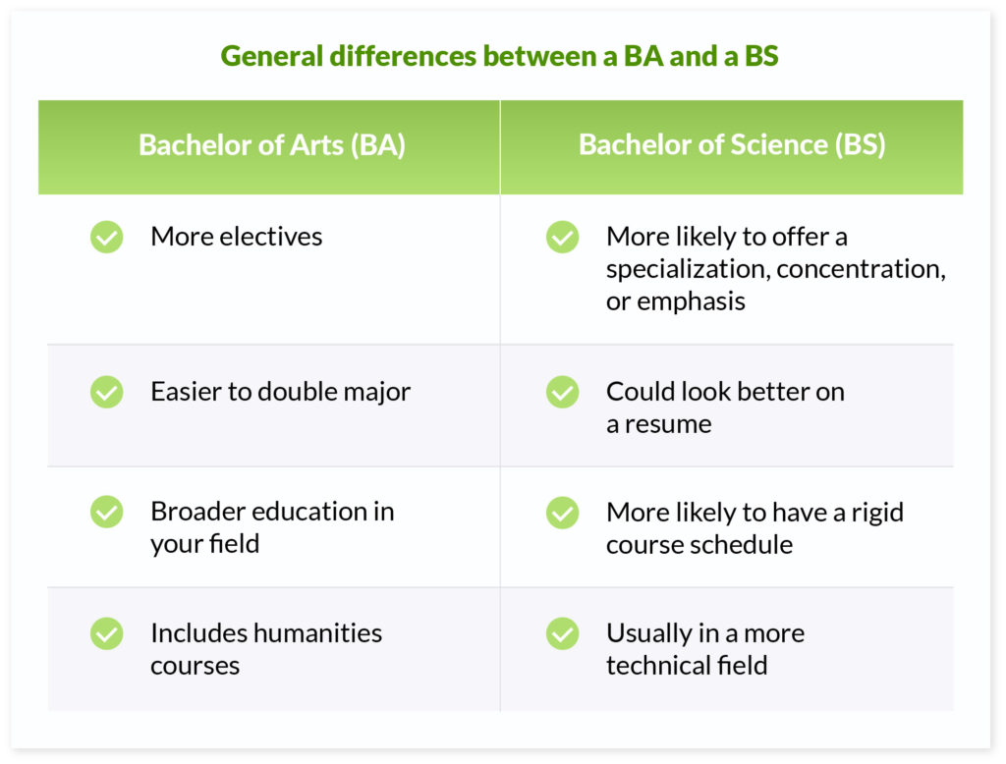
College Majors
hi

Slide 6
Common College Vocab
What’s an Elective?
A course that you choose from a list, tends to be specialized and has fewer students in the class.
For example, if you were a business major and wanted to own your own business in Asia, you could choose electives on Chinese history, entrepreneurship, or learning Japanese.
Or if you were majoring in Psychology, you could take electives based around counseling children.
hi

Slide 7
Common College Vocab
What’s an Elective?
It can also be something that you are interested in learning, such as guitar or astronomy.
Just remember that you are paying for these classes, so you probably don’t want to take too many of these classes that do not apply to your major.
hi

Slide 8
Common College Vocab
What’s a Humanity?
A humanities class or major focuses on critical thinking and creativity.
Humanities majors include history, literature, and foreign languages.
hi

Slide 9
Today’s College Prep Assignment
In the comments section of today’s College Prep,
using the three majors you chose last class, write whether they are a B.A. or B.S.
What does this information tell you about your interests and your future career options?
hi

